Slide 1
Device as a Service Project Introduction
Jan, 2022

Slide 2
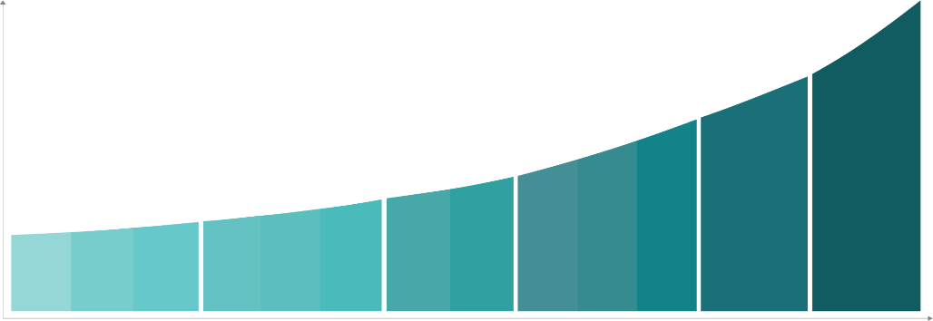






Solution Function
Your maintenance efficiency leverage
Maintenance assistance
Preventive maintenance supporting.
Predictive maintenance suggestion.
Prescriptive maintenance strategy.
Increase maintenance efficiency.
Key failure detection
Statistic analysis on horizontal and historical views.
Abnormal detection of key devices.
Fault diagnosis on high incidence failure. Fault diagnosis with edge analysis and machine learning.
Value Creation
Asset condition monitoring
Strong domain know-how integration.
Multi detection method with high accuracy.
OT&IT combination.
Continuously remote condition monitoring.
Digital Transformation

Slide 3
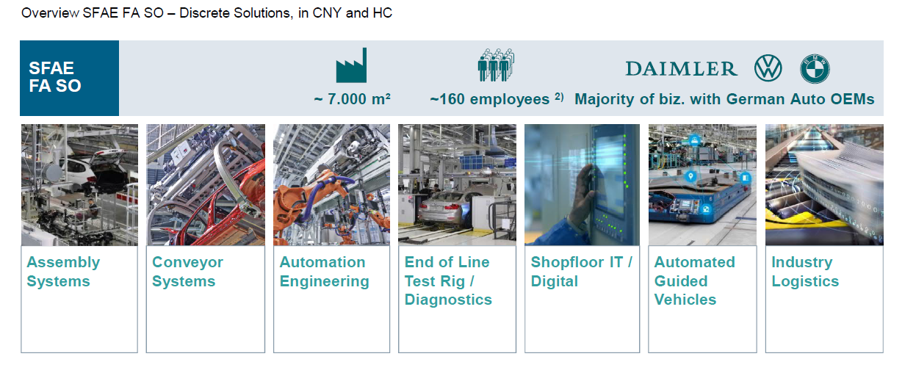
Business Partner
Derived from Automotive Industry

Slide 4
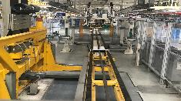
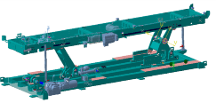
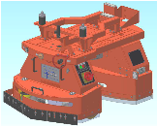

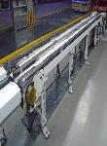
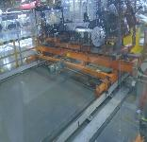

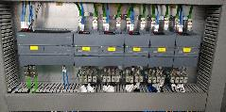
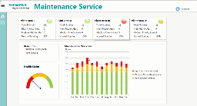
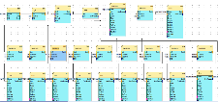


Project Path
Pilot project
Device as a Sevice (DaaS) on FAW-VW Chengdu
Marriage line(shaft) data acquisition and edge computing
MindSphere solution, deliver MindApp
Customer factory setup and deployment
Implementation project
Device as a Sevice (DaaS) on SAIC-VW CP3 Shanghai
Assembly Line, Marriage Line Chain Conveyor, Bodyshop Lifter data acquisition and edge computing
Multi-sensor solution comparison
Local server solution
Customer factory setup and deployment
Follow up project
Device as a Sevice (DaaS) Mindsphere R&D Project
Maintanence MindApp development
AGV data acquisition and edge computing
Experience center setup and deployment
1st project
“Aiways” Lifter Mindsphere R&D Project
Lifter data acquisition
Edge computing on vibration analysis
Data transmission to MindSphere
MindAPP system design
Aug. 2018
Jun. 2019
Dec. 2019
July. 2020
FAW-VW factory
SAIC-VW factory
Lifter
AGV

Slide 5










Architecture
Server Level
Field-Edge-Cloud
Maintenance APP
Continuously remote condition monitoring.
Maintenance notification, abnormal event, and maintenance feedback acquired from filed engineers.
History comparison and regular report generation.
Cloud Platform
Real time analysis, big data and knowledge graph storage.
Knowledge graph based device and system modeling.
Close-loop solution and process flow optimization for maintenance.
Edge computing
Combine OT and IT systems.
Industrial edge data preprocessing, feature extraction and machine learning algorithm integration.
Statistic calculation and pattern identification
Connectivity
Data collection from control and field systems.
OT and IT data fusion.
Siemens industrial sensors and gateway integrated to detect mechanism component.
Maintenance APP
IIoT Platform
Edge level
Edge computing
IT Systems
Domain know-how essential on all 3 layers
Field level
Core Assets
Connectivity
…
…
…
…

Slide 6
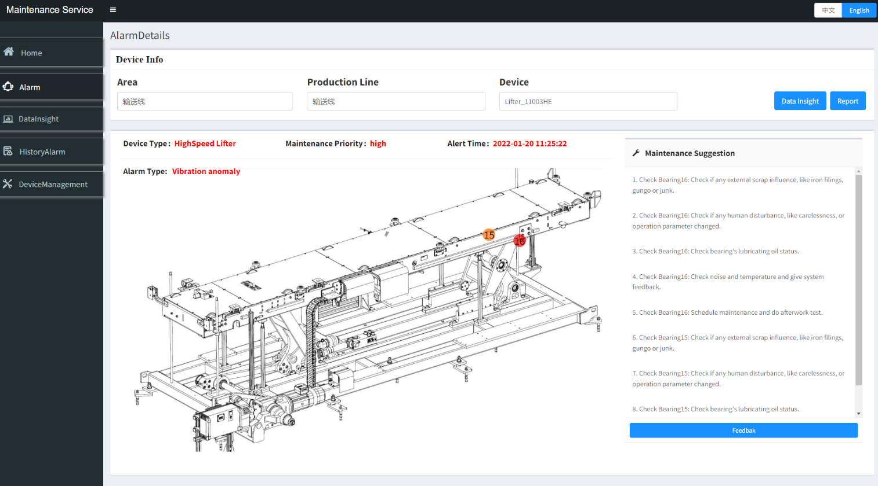
Maintenance service

Slide 7
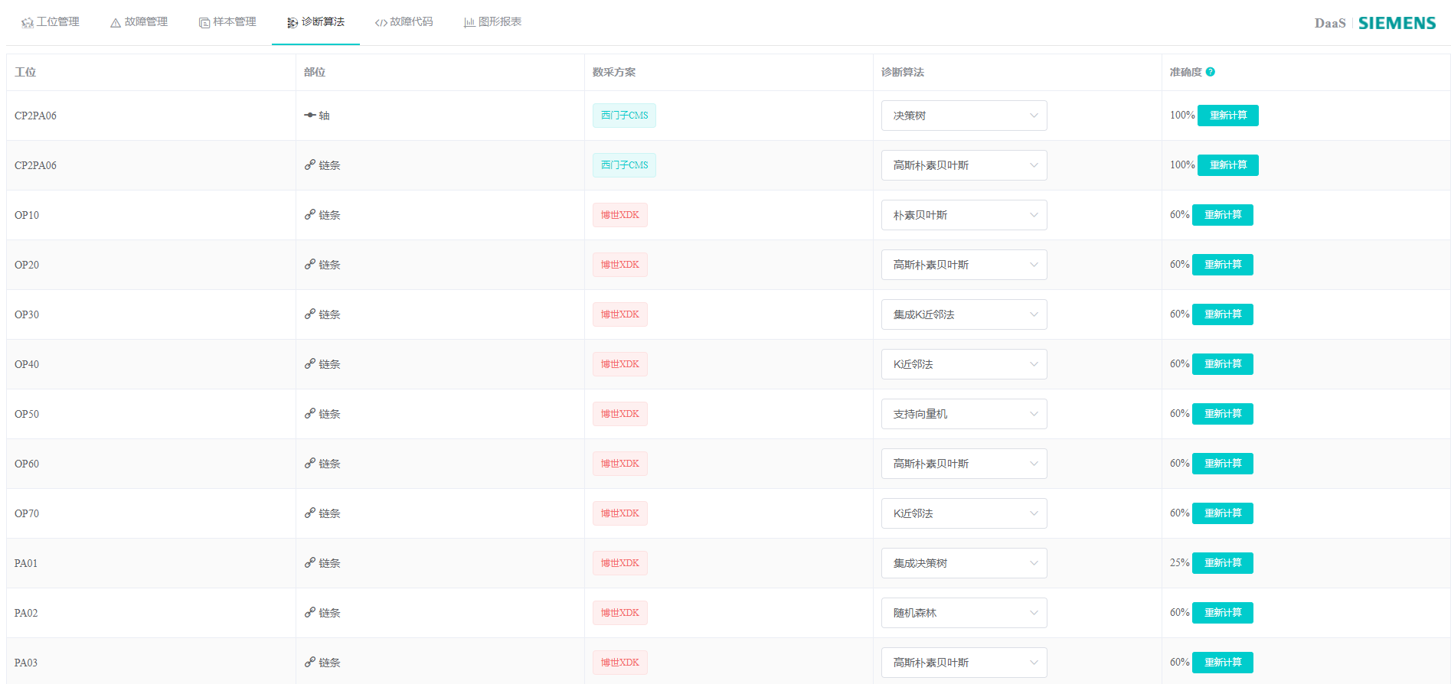
EdgeTool

Slide 8
Continuously development of technology in DaaS
Multi-type AGV data acquisition and edge computing
Multi-protocol data acquisition
Edge computing by self-develop module, embedded into IoT2040
Data transfer to MindSphere by OEDK
Basic framework and maintenance MindApp Development
Chain Conveyor of assembly line data acquisition and edge computing
Local version big data storage (TimeScale DB)
Combined analysis in frequency domain and time domain
Edge analysis configuration tool design (Electron/Innovation)
Wechat Mini-program (communication with MindSphere)
Reconstructed frontend and backend coding, database, etc.
Root cause analysis of production bottleneck, combined with maintenance alarm and SiPlant operation system data.
OPC of Industry Edge solution integration.
Aug, 2018
Dec, 2019
July, 2020
June, 2019
March, 2020
Dec, 2021
End of line device solution Insight
Add label for data sample
Data export function tool for on-site engineer
Integrated with end-customer IT system
Maintenance knowledge graph (blazegraph) in MindSphere
Local version solution design
Experience center setup and deployment
HighSpeed Lifter data acquisition
Edge computing on vibration analysis (X-tools)
Data transmission to MindSphere (MindConnect Nano)
MindAPP system design
Continuous technology upgrade

Slide 9
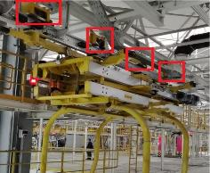
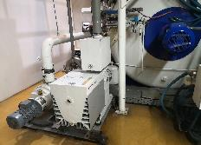
Incoming
Projects
Technology
Data governance
Quick-starter project
Aims to do real-time data governance and management before data storage to ensure data quality based on semantic technology.
Wireless smart sensing kit for quick validation
Quick-starter project
Aims to enhance field data acquisition and fast algorithm validation for prototyping based on TinyML technology.
Indirect maintenance
Aims to realize alert and maintenance based on indirect sensing like current data instead of installing additional sensors or devices.
PoC already done with business partner
FAW-VW: Rubber Coating Wheel
SMVS: Vacuum Oven
* In 1st half of 2022

Slide 10
Contact
Published by Siemens
T RDA IoT INW-CN
YU He 200, Linghu Avenue 214135, Wuxi China
Mobile: +86 18921506861
E-mail: yu-he@siemens.com
T RDA IoT INW-CN
YANG Shao Peng 200, Linghu Avenue 214135, Wuxi China
Mobile: +86 18262273079
E-mail: shaopeng.yang@siemens.com

Slide 11
Use Case DaaS-SAIC VW Project

Slide 12













Solution Overview in SAIC VW CP3
Server Level
Data Processing & Analysis
Maintenance Service
1*
Server + DB Storage
Edge Level
MQTT
Modbus
TCP
Route
+
IFM
Data Acquisition
Sampling Cycle:1s
Siemens
Data Acquisition
Sampling Cycle:0.05ms
Bosch Gateway
Sampling Cycle:1s
CMS2000
Field Level
Bosch XDk110
Hybrid Sensor
IFM
Vibration Sensor
PCB
Vibration Sensor
Chain Conveyor
PA01-PA14
Cross Conveyor
4010\4030
Chain Conveyor
OP10-OP70
Chain Conveyor
PA15
Chain Conveyor
PA16

Slide 13
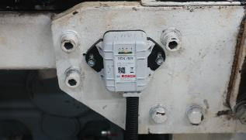
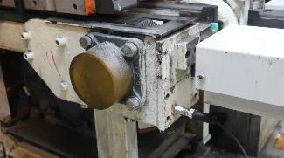
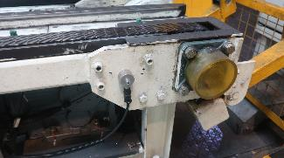
On-Site Sensor Installation in Assembly Line
Z
for Chain
X
Y
for Motor
Y
Z
for Motor
for Chain
X
Bosch XDK110
Hybrid Sensor
（Monitoring Device）
IFM VSA001
Single-Axis Vibration Sensor （Monitoring Chain and Motor）
PCB
604B31 Three-Axis Vibration Sensor
627A01 Single-Axis Vibration Sensor
（Monitoring Chain and Motor）

Slide 14
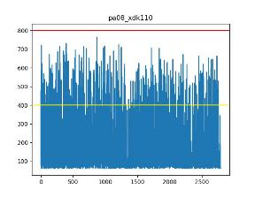
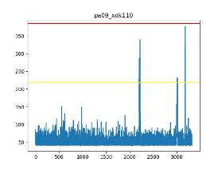
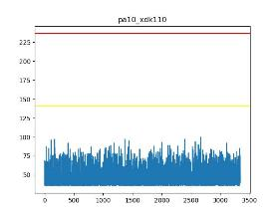
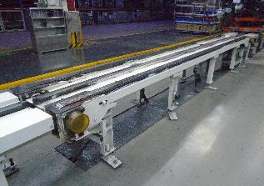
Successful Case
SAIC-VW, Audi Line
Plant | SAIC VW CP3
Device | Chain Conveyor
CarType | Audi/Tiguan/Phaeton
Cycle | 32 JPH
Solution | Local Server Solution
Data Characteristics
Fault Station：PA08
Characteristics：The monitoring data value is continuously abnormally high energy, higher than the algorithm threshold.
Feedback from engineer： The chain nylon strip is worn and needs to be replaced when stopping production. It is estimated that the repair time is at least 4 hours.
Impact Station：PA09
Characteristics： The monitoring data value has burst abnormal energy, which is higher than the algorithm threshold
Feedback from engineer：The production line has been reformed for many times, and there is misalignment between stations; or the abnormal vibration of pa08 affects pa09Continue to pay attention
Normal Station：PA10
Characteristics：Data value is normal, low and stable vibration energy.
Chain wear-out Failure
Data Source：vibration sensor，unit: mm/s2 (g=m/s2)；
Data Segment：2020-08-27 10:00:00 ~2020-08-28 12:00:00
Remarks：In the early stage of project implementation, there was no single station historical data, so the comparison of adjacent stations

Slide 15




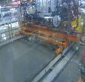

Solution Portfolios of DaaS
Maintenance services
System Integration
Alarm，
Maintenance suggestion
Employee database For querying the responsible employee
!
!
Existing
system
Technician
arrangement
AGV
Transfer components health data
!
Spare parts mgmt.
For querying needed spare parts
Spare parts
arrangement
Cloud/server
Chain conveyor
!
Maintenance suggestions
!
Data Acquisition
&
Edge Computing
Service technician
Cross conveyor
Device/Station
Page 15

Slide 16
Questions?
Answers!

